Slide 1

ENHANCING STOCK PRICE PREDICTION WITH LSTM AND RNN

Slide 2

Team working on this
Chaitanya
-Data scientist
Sai Teja -Research Enigineer
Renuka
-Data Enigineer
Santhosh -Cloud architect

Slide 3

Business Overview
Problem 1
Inaccurate Predictions:
"Developing a model to predict whether a customer will purchase a product based on their browsing behavior, but the model often predicts incorrectly, leading to missed sales opportunities."
Limited Model Flexibility
"Developing a stock price prediction model that relies solely on historical price data but fails to adapt to sudden market changes, resulting in inaccurate predictions during volatile market conditions."
Problem 3
Lack of Timeliness
"Developing a model to predict daily stock prices based on historical data, but the predictions are often outdated by the time they are available, leading to missed trading opportunities."
Problem 2

Slide 4
Solution Overview
LSTM and RNN models with flexible architectures,transfer learning techniques, and customizable parameters ensure relevance and accuracy,while providing users with personalized investment strategies.
Use advanced deep learning methods like LSTM and RNN to understand and predict how stock prices change over time. Also, use smart ways to extract important information from past stock prices to make better predictions.
Develop a system that uses live data to predict stock prices in real-time. This system will be set up in the cloud, providing timely updates and alerts for market events.

Slide 5

Business Model
Objective: Enhance stock price prediction with LSTM and RNN for smarter investment decisions.
In the fast-moving world of finance, predicting stock prices accurately is crucial for investors, traders, and financial institutions to make smart decisions and earn more money from their investments.
The usual ways of predicting stock prices aren't great at understanding the complicated patterns in financial data. So, there's a big challenge to create better models that can predict stock prices more accurately.
We're using fancy math to predict stock prices better. Our goal is to make a tool that helps investors make more money by predicting stock prices more accurately.

Slide 6

Modeling
Modeling
Design LSTM and RNN architectures for stock price prediction.
Define input layers to receive sequential data.
Set up output layers to generate predictions.
Configure LSTM and RNN layers with appropriate parameters (e.g., number of units, activation functions, dropout rates).
Compile the model with suitable loss functions, optimizers, and evaluation metrics.
Train the model on historical stock price data.
Evaluate the model's performance using validation datasets.
Adjust parameters and architecture as needed for better performance.
Repeat training and evaluation until satisfactory results are achieved.

Slide 7
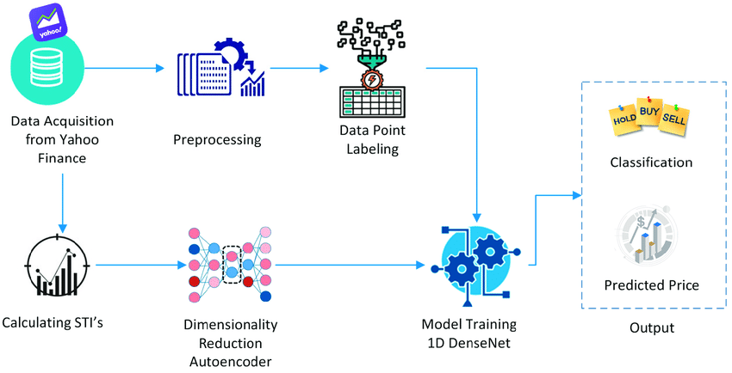
Methodology

Slide 8
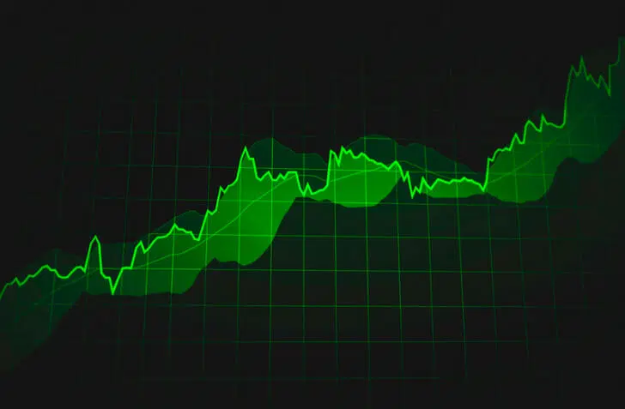
Evaluation
Measuring performance by comparing our predicted stock prices with the actual prices using metrics like MAE and RMSE helps us gauge the accuracy of our predictions.
Evaluating how well the model captures the trends, patterns, and changes in stock prices across various timeframes.
Check if the model's predictions match the actual prices to see how well it works in real situations.
Analyze how the model performs when you change its settings like learning rate or batch size.
Evaluate how well the model handles new, unseen data or volatile market conditions to ensure it can make accurate predictions in various situations.
Evaluation for Enhancing Stock Price Prediction with LSTM and RNN

Slide 9

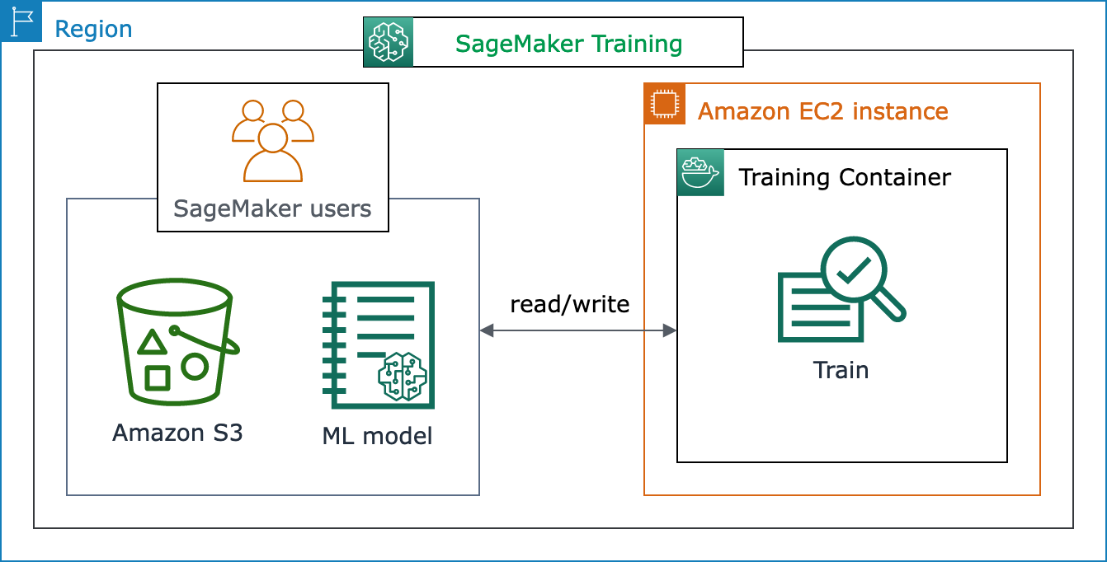
Deployment

Slide 10


